Slide 1
Sending Messages
October 21, 2013
Notes:
Guidewire training materials contain Guidewire proprietary information that is subject to confidentiality and non-disclosure agreements. You agree to use the information in this manual solely for the purpose of training to implement Guidewire software solutions. You also agree not to disclose the information in this manual to third parties or copy this manual without prior written consent from Guidewire. Guidewire training may be given only by Guidewire employees or certified Guidewire partners under the appropriate agreement with Guidewire.

Slide 2
Describe the plugins used in sending messages
Set sender reference IDs and late bind messages
Write message request plugins
Write message transport plugins
Describe the functionality of safe ordering
Describe how errors are handled when sending messages

Slide 3
Sending message plugins
SenderRefIDs and late binding
The message request plugin
The message transport plugin
Safe ordering
Retrying messages during sending

Slide 4
Messaging plugins
A messaging destination calls messaging plugin to…
Handle the late binding of a generated message
Send a message
Acknowledge a received message
Request Plugin
Handles the late binding of an message about to be sent
Transport Plugin
Sends the message
Acknowledges synchronous replies
Reply Plugin
Acknowledges a received message
Request Plugin
Transport Plugin
Reply Plugin
Notes:
A plugin is a defined program that perfoms an action, for example, authenticates a user, generates a number for checks, or sends a message to an external system. A plugin can implement either a Gosu or Java class.
A plugin implements a
A predefined plugin executes generic functionality unrelated to messaging. You can have only one implementation of a given predefined plugin (such as authentication) per application.
Only one plugin of each type can be defined per destination.
Multiple destination can specify the same plugin type

Slide 5

Plugins for sending a message
payload transformation
Request Plugin
external system
xx_message
sending message
Transport Plugin
Reply Plugin
Notes:
The request plugin is an optional plugin that is responsible for late binding. Late binding is the process of changing a payload immediately before the message is sent to include values that cannot be determined when the message is generated.
The transport plugin is a required plugin that is responsible for sending the message to the external system. This could consist of:
Sending the payload to a JMS (Java Messaging Service) queue.
Using the payload to compose a SQL statement (such as an insert into a third-party database table).
Writing the payload to an external file.
Writing the payload to a console or log file (for debugging and testing)
If acknowledgements are expected synchronously, the transport plugin also manages acknowledgements.
The reply plugin, if there is one, is not involved in the sending of messages.

Slide 6

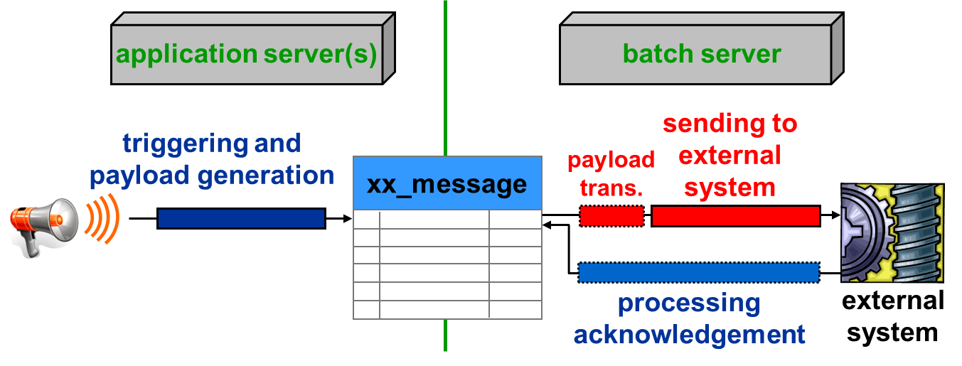
Message send transactions
Application server(s)
Batch server
triggering and payload generation
sending to external system
xx_message
payload
tran 1
tran 2
tran 3
tran 4
processing acknowledgement
external system
Payload transformation
Within Request Plugin scope
Sending the message
Within the Transport Plugin scope

Slide 7
Sending message plugins
SenderRefIDs and late binding
The message request plugin
The message transport plugin
Safe ordering
Retrying messages during sending

Slide 8

SenderRefIDs
message ab:61
Guidewire application
message ab:61 processed
External system
When message acknowledgement is asynchronous, the external system needs a way to identify which message it is acknowledging
To do this, a SenderRefID is assigned to the message when it is sent
When the external system sends an acknowledgement, it uses the SenderRefID to identify the message
Notes:
In some cases, a message does not need a reply from the external system. These are "fire and finish" messages where Guidewire must simply inform some other system of some event, but Guidewire does not get any response from the other system. In other cases, a message is replied to synchronously at the time that it is sent. In both cases, there is no need to set the SenderRefID field. Guidewire synchronously marks the message as acknowledged within the transport plugin's send() method.

Slide 9
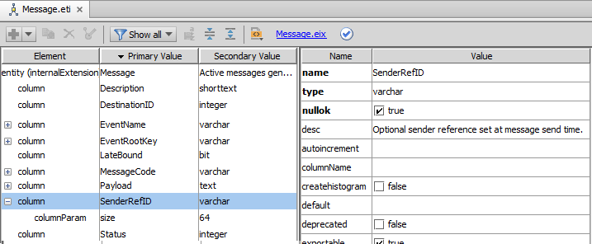
SenderRefID field
Optional identifier
Guidewire application adds during late binding
External systems sets in acknowledgement
Notes:
All entities, including Message, have a PublicID field. The purpose of this field is to identify instances of the entity as they are known by the external system. Thus, the purpose of the SenderRefID field is identical to that of the PublicID field. The Message entity has two "public identification fields" because earlier versions of the Guidewire applications did not have the PublicID field across all entities. However, the Message entity absolutely required a settable field that could be shared with external systems, and so Message was created with the SenderRefID field. As the Guidewire applications matured, the PublicID field was added to entities in the data model. This allowed other entities beyond Message to be shared with external systems.
Even though you theoretically could use Message's PublicID field, Guidewire recommends you use SenderRefID instead. There are numerous base application methods that make use of SenderRefID, such as IMessagingToolsAPI's getMessageID() method that takes the SenderRefID as an input and the MessageFinder's findHistoryBySenderRefID() method). Using PublicID to identify a message could make an implementation more complex.

Slide 10
Guidewire determines SenderRefID…
SenderRefID handled in late binding
Request Plugin
external system
xx_message
sending message
sending message
Transport Plugin
When the request plugin handles late binding
Sets the SenderRefID
Adds the SenderRefID to the message payload
The transport plugin sends the payload (with the ID) to the external system
Notes:
When a message is replied to asynchronously, a Guidewire application can generate a message identifier that is acceptable to the external system. The SenderRefID is an option identifier that the external system can use to manage Guidewire application messages.

Slide 11
External system determines SenderRefID…
Request Plugin
external system
xx_message
sending message
sending message
Transport Plugin
synchronous reply
SenderRefID saved
SenderRefID sent immediately
The request plugin does not handle the SenderRefID
The transport plugin:
Sends the message
Receives the SenderRefID value from the external system
Sets the SenderRefID field for the message
Notes:
A request plugin can set the SenderRefID field during late binding of the message. This is helpful for setting the SenderRefID to the PublicID of the message being sent. The PublicID is only discoverable after the Guidewire application generates the initial message and commits the message to the database. Generating the message and the message payload occurs during the Event Fired rules. Of course, it is possible to set the SenderRefID for the message to another value, but a common approach in these situations is to simply set the SenderRefID to the PublicID during late binding.

Slide 12
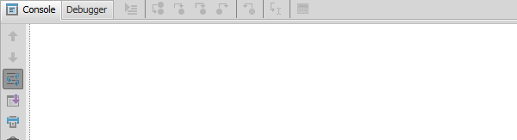
Late binding values
*** Stage 3(a) -- Transforming the message payload with late binding ***
Request plugin: BankAccountVerificationRequest – beforeSend()
Message ID is 630
Replaced token <@@ageOfMessageInSeconds@@> with value 3
Returning payload string
Replace token with age in seconds
A late binding value is a message payload value that cannot be determined until right before the message is sent
The message request plugin is responsible for replacing all late binding values with actual values
Request Plugin
Notes:
Good candidates for late binding include:
A send timestamp
The message ID and/or its public ID
An identifier from the external system that was sent in reply to a previous message
For example, imagine an integration point in which the first message communicates that a new entity was added. The reply to the first message contains the ID to be used for the new entity on the external system. The second message identifies a change on this new entity. However, the second message is created before the first message has been sent (or before the reply to the first message has been received). The second message must use the ID in the reply to the first message. The only way this ID can be added to the second message is through late binding.
Typically, values that are to be late bound are added to the message payload using a placeholder marked by special character delimiters, such as <@@ and @@>. In the message request plugin, these placeholders are replaced with the required data.
Be careful about what data you set via late binding. Typically, the message payload should reflect a consistent snapshot of the system at the time the Event Fired rule executed. Late binding should not be used to capture entity data after message creation.

Slide 13
Plugins for sending messages
SenderRefIDs
Message request plugin
Message transport plugin
Safe ordering
Retrying messages during sending

Slide 14
Message request plugin
SenderRefID and/or late binding
Request Plugin
xx_message
sending message
The message request plugin is responsible for:
Setting the SenderRefID and adding the value to the message payload (when replies are asynchronous and Guidewire can determine the ID)
Setting any other non-SenderRefID late binding values

Slide 15
beforeSend() – override
39 override function beforeSend(aMessage : Message) : String {
…43 var payload = aMessage.Payload
44 var ageInSeconds = DateUtil.secondsSince(aMessage.CreationTime)
45 as java.lang.CharSequence
46 var token = "<@@ageOfMessageInSeconds@@>"
47 if (payload.containsIgnoreCase(token)) {
48 payload = payload.replace(token, ageInSeconds )
…49 }
…51 return payload
52 }
gw.plugin.messaging.MessageRequest
Message request plugin class must implement interface
Override beforeSend()
beforeSend()
Called before message is sent
Must always return a String, even if payload is not transformed
Notes:
Payload transformation is done in the request plugin's beforeSend() method. It is called immediately before the message is sent. The method must always return a payload.
If the payload is not transformed, then the original payload should be returned.

Slide 16
beforeSend() – transform payload
39 override function beforeSend(aMessage : Message) : String {
…43 var payload = aMessage.Payload
44 var ageInSeconds = DateUtil.secondsSince(aMessage.CreationTime)
45 as java.lang.CharSequence
46 var token = "<@@ageOfMessageInSeconds@@>"
47 if (payload.containsIgnoreCase(token)) {
48 payload = payload.replace(token, ageInSeconds )
…49 }
…51 return payload
52 }
Do NOT modify the message payload field directly
Modify the content of payload for sending final values
Replace tokens with late binding values
Return the transformed payload
Notes:
You can modify the message payload using a placeholder or token. Often, tokens and placeholders are designated with special character delimiters, such as <@@ and @@>. In the beforeSend() method, these placeholders are replaced with the required data for late binding.
In some situations, the initial sending of the message is unsuccessful. This could be because of a problem with the Guidewire application or with the external system. In these situations, the message needs to be resent. Because a message may be sent multiple times, the beforeSend() method may be called multiple times. Therefore, the beforeSend() method should not modify the message payload directly. Instead, it should return a transformed payload. This lets later attempts to send the message update the payload as appropriate.

Slide 17
Setting the SenderRefID in beforeSend()
35 override function beforeSend(aMessage : Message) : String {
…44 if (aMessage.SenderRefID == null) { 45 aMessage.SenderRefID = aMessage.PublicID
…47 }
48 var transformedPayload = aMessage.Payload.replace(
49 "<@@senderRefID@@>", aMessage.PublicID)
…51 return transformedPayload
52 }
Set SenderRefID only if it hasn't already been set
Line 44 – 47: Guidewire may need to attempt the send multiple times, but a single SenderRefID should be used for all attempts to send the same message
Once set, SenderRefID should be added to the payload
Line 48-49: Replace token with value
Notes:
When an asynchronous reply is received, the SenderRefID is used to locate the message to acknowledge, even if the message was sent multiple times. As long as all automatically retried messages have the same SenderRefID as the original, Guidewire can find the correct message to acknowledge, regardless of which specific instance the external system is replying to.
In the example above, the SenderRefID is set to the message's public ID. Theoretically, the public ID shouldn't change with multiple calls to the beforeSend() method. So in this particular case, it is unlikely that the SenderRefID would change, even if it was reset multiple times. Nevertheless, it is best practice to set the SenderRefID only once, and to check that the value is not null prior to setting it.
In the example above, the code that inserts the SenderREFID value into the payload is located outside of the "if SenderRefID is null" branch. This is because SenderRefID should be set only if it hasn't already been set, but the SenderRefID should always be added to every transformed payload, regardless of when the SenderRefID value was set.

Slide 18
Message request plugin implementation
Create the request plugin class
Implement the MessageRequest interface
Implement beforeSend() as needed
Create the plugin registry
Configure the plugin
Specify the destination plugin
Deploy your changes

Slide 19
Step 1: Create request plugin class
1 package acme.ta.messaging.bank
2 uses gw.plugin.messaging.MessageRequest
3 uses gw.pl.messaging.entity.Message
… 6 class BankAccountVerificationRequest implements MessageRequest {
…39 override function beforeSend(aMessage : Message) : String {
…43 var payload = aMessage.Payload
…51 return payload
52 }
53 }
Create Gosu plugin class in \configuration\gsrc\
Use a package naming convention recommendation
<company>.<app_code>.messaging.<functional_area>
Implement the MessageRequest interface
Message entity instance is in transaction scope
Must override beforeSend()
Notes:
You can modify the message payload using a placeholder or token. Often, tokens and placeholders are designated with special character delimiters, such as <@@ and @@>. In the beforeSend() method, these placeholders are replaced with the required data for late binding.
In some situations, the initial sending of the message is unsuccessful. This could be because of a problem with the Guidewire application or with the external system. In these situations, the message needs to be resent. Because a message may be sent multiple times, the beforeSend() method may be called multiple times. Therefore, the beforeSend() method should not modify the message payload directly. Instead, it should return a transformed payload. This lets later attempts to send the message update the payload as appropriate.

Slide 20
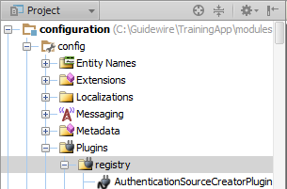
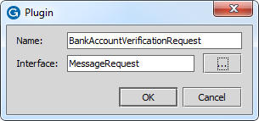

Step 2: Create the plugin registry
\configuration\config\plugins\registry\
New → Plugin
In the dialog, specify Plugin name and MessageRequest interface
Example:
BankAccountVerificationRequest

Slide 21
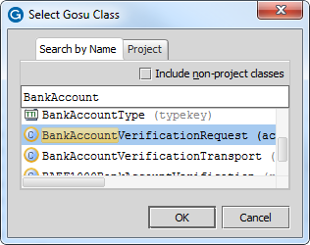
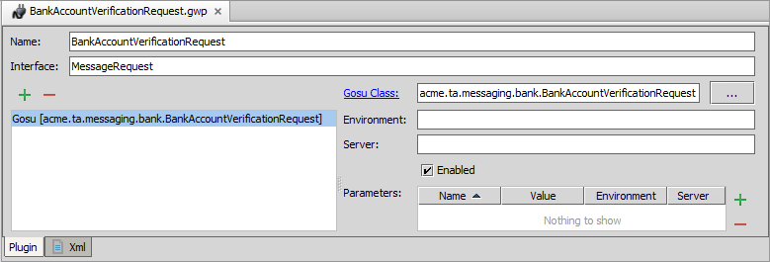

Step 3: Configure the plugin
Add Gosu or Java Plugin
Click the ellipse (...)
Select the Class in the dialog
Example:
BankAccountVerificationRequest

Slide 22
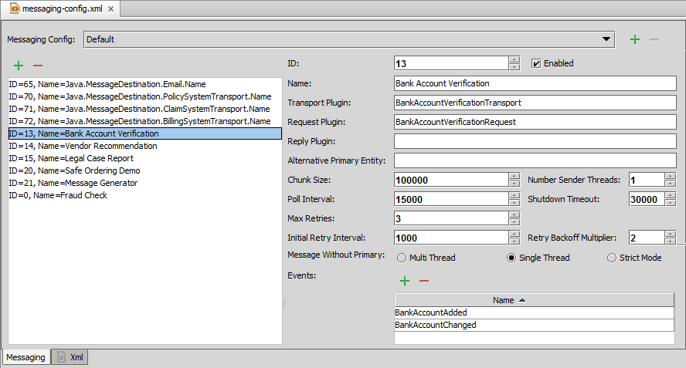
Step 4: Specify the destination plugin
\configuration\config\messaging\messaging-config.xml
Click Add
The destination must point to a plugin registry element that references the appropriate Message Request plugin
Notes:
For non-messaging plugins (such as authentication), you can implement only one version of each plugin at a time. For messaging plugins, you can implement any number of MessageRequest, MessageTransport, and MessageReply plugins.
Every destination can use only one message transport plugin. Theoretically, a given message transport plugin class can be used by multiple destinations. However, this would be uncommon for most types of destinations, except for standardized cases, such as simple transport of the payload as a text message sent to a JMS destination.

Slide 23
Step 5: Deploy message request plugin
Restart
Make Project or Reload Changed Classes
Destinations
Plugin registry elements
Request Plugin Gosu class
Destination
Plugin Registry
Request Plugin Gosu Class
Notes:
If you implement your message request plugin in Java, then you will need to compile the Java class and recopy it into the Guidewire directory structure.

Slide 24
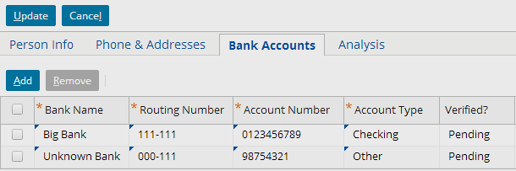

Example: Late binding
Request Plugin
Payload transformed late binding
*** Stage 3(b) -- Transforming the message payload with late binding ***
Request plugin: BankAccountVerificationRequest – beforeSend()
Message ID is 303
Replaced token <@@ageOfMessageInSeconds@@> with value 10 Returning payload string
Notes:
The example above shows the triggering entity in the user interface (a savings account for William Andy, whose public ID is ab:5), the request plugin's beforeSend() method, and the payload generated for that message. Note that the age in seconds has been added to the payload.

Slide 25
Sending message plugins
SenderRefIDs and late binding
The message request plugin
The message transport plugin
Safe ordering
Retrying messages during sending

Slide 26
Message transport plugin
SenderRefID and/or late binding
Request Plugin
external system
xx_message
sending message
Transport Plugin
The message transport plugin is responsible for sending the message
Notes:
Communication with the external system may use any type of connectivity or transport, including some not normally considered "messaging", such as:
File-based, shared database
Raw socket (TCP/IP)
FTP
Email
Synchronous invocations, such as RMI/JRMP, RMI/IIOP, and SOAP.
Asynchronous, message-based transports, such as JMS, native WebSphere MQ, or SOAP/JMS.
A message request plugin can optionally implement the InitializablePlugin interface, which adds the setParameters method to the plugin. However, there is rarely a need for this with a Request plugin, as the plugin typically does the same thing in any environment.

Slide 27
send() – override
31 override function send(aMessage: Message, transformedPayload: String) {
32 print("\n*** Stage 3(b) -- Sending the message ***")
…40 // send payload to console 41 print(" Sending payload to console for Message ID " + aMessage.ID + " as: \n" + transformedPayload) …52 // Acknowledge message synchronously… …54 aMessage.reportAck() …55 print(" Acknowledged Message ID " + aMessage.ID + " synchronously")}
…65 }
gw.plugin.messaging.MessageTransport
Message transport plugin class must implement interface
Override send()
send(Message,String)
Input parameters are message and transformed payload
Process synchronous acknowledgements
Notes:
When a message is to be processed:
The request plugin's beforeSend() method is called (if the destination has a request plugin), and then...
The transport plugin's send() method is called
Message acknowledgement, whether it is synchronous or not, is discussed in the next lesson.
Messaging code (including code in Event Fired rules, beforeSend(), and send()) must be extremely careful about modifying entity data. It should perform only the minimal data changes necessary for integration with the target external system. Changes in this code will NOT run or any validation or preupdate logic. Messaging code should not change fields that might require those rules to run.
Each message should be sent to no more than one external system. This ensures that every message can expect a reply from one external system and the state of the message is never in question. If you need to alert multiple systems to a single event, then create multiple destinations and have each destination listen for the same event and prepare its own message.
After the message is sent, other activities in the send() method should be minimal.
The request plugin also has an afterSend() method, which is called immediately after the transport plugin's send() method. The afterSend() method can be used for any post-send processing that is unrelated to how the message is acknowledged. Because the message represents a point-in-time state, and because any exception thrown in the afterSend() method will cause the message to be resent, any code in the afterSend() method should be kept to a strict minimum.

Slide 28
send() – to file example
33 override function send(aMessage: Message, transformedPayload: String) {
34 print("\n*** Stage 3(b) -- Sending the message ***")
…36 // send payload to file 37 print(" Sending payload to file c:/Guidewire/Vendor" + (aMessage.ABContactID as Key) + " .txt" ) 38 var file = "c:/Guidewire/Vendor" + (aMessage.ABContact as Key) + ".txt" 39 var output = new BufferedWriter(new FileWriter(new File(file)))
40 // send message payload to file
41 output.write(transformedPayload)
42 output.close()
42 }
Notes:
The send method uses Gosu's Java file I/O capabilities to write the payload to a simple flat file. The payload contains information about the evaluations for that vendor.
See the VendorRecommendationTransport.gs file for more details.

Slide 29
send() – to web service example
27 override function send(aMessage: Message, transformedPayload: String) {
28 print("\n*** Stage 3(b) -- Sending the message ***")
…30 // creating web service
31 var API = new acme.ta.messaging.legalreport .legalreportwsc.legalreportapi.LegalReportAPI()
32 // setting web service authentication properties
33 API.Config.Http.Authentication.Basic.Username = "ExternalAppUser" 34 API.Config.Http.Authentication.Basic.Password = "gw"
…36 print(" Sending payload to web service " + aMessage.ID )
37 // send message payload to web service 38 API.submitReportRequest(transformedPayload)
…54 }
Notes:
The send method uses a web service collection to send a request for a legal case report to an external system using a web service API. See the LegalReportTransport.gs file for more details.

Slide 30
Steps to implement message transport
Create the message transport plugin class
Implement the MessageTransport interface
Implement send() as needed
Create the plugin registry
Configure the plugin
Specify the destination plugin
Deploy your changes

Slide 31
Step 1: Create transport plugin class
1 package acme.ta.messaging.bank
2 uses gw.plugin.messaging.MessageTransport
3 uses gw.pl.messaging.entity.Message
… 6 class BankAccountVerificationTransport implements MessageTransport {
…39 override function send(aMessage: Message, transformedPayload: String) {
…40 // send message payload to console 41 print(" Sending payload to console for Message ID " + aMessage.ID + " as: \n" + transformedPayload) 52 }
53 }
Create Gosu plugin class in \configuration\gsrc\
Use a package naming convention recommendation
<company>.<app_code>.messaging.<functional_area>
Implement the MessageTransport interface
Must override send()

Slide 32
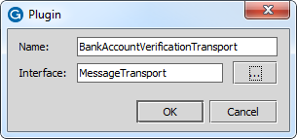
Step 2: Create the plugin registry
\configuration\config\plugins\registry\
New → Plugin
In the dialog, specify Plugin name and MessageTransport interface
Example
BankAccountVerificationTransport

Slide 33
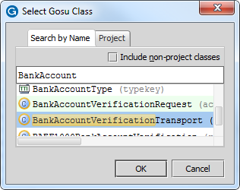
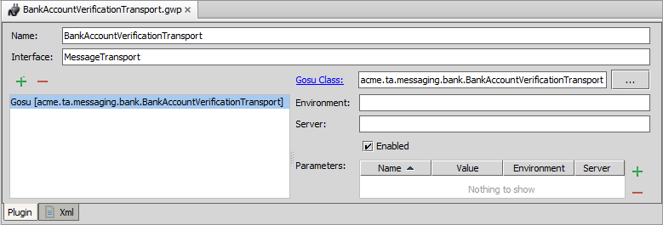
Step 3: Configure the plugin
Add Gosu or Java Plugin
Click the ellipse (...)
Select the Class in the dialog
Example:
BankAccountVerificationTransport

Slide 34
Step 4: Specify the destination plugin
\configuration\config\messaging\messaging-config.xml
Click Add
The destination must point to a plugin registry element that references the appropriate Message Transport plugin

Slide 35
Step 5: Deploy message Transport plugin
Restart
Make Project or Reload Changed Classes
Destinations
Plugin registry elements
Request Plugin Gosu class
Destination
Plugin Registry
Transport Plugin Gosu Class
Notes:
If you implement your message request plugin in Java, then you will need to compile the Java class and recopy it into the Guidewire directory structure.

Slide 36
Example: Send to the console
BankAccountVerification Transport Plugin
sending message
*** Stage 3(b) -- Sending the message ***
Transport plugin: BankAccountVerificationTransport -– send()
The Request Plugin transformed the payload
Sending payload to console for Message ID 1303 as: contact,ab:5
bankName,Big Bank
routingNumber,111-111
accountNumber,0123456789
accountType,checking

Slide 37
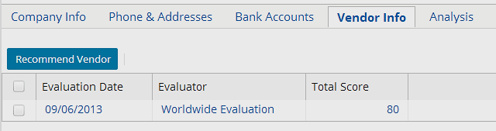
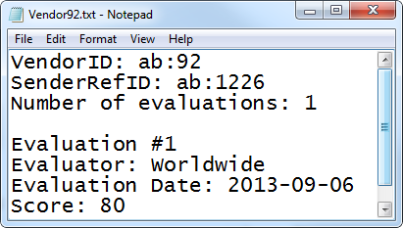
Example: Send to file
VendorRecommendation Transport Plugin
sending message
*** Stage 3(b) -- Sending the message ***
Transport plugin: VendorRecommendationTransport – send()
Sending payload to file c:/Guidewire/Vendor92.txt
Notes:
The VendorRecommendationTransport class's send() method prints the payload to a file using Java's I/O capabilities.

Slide 38
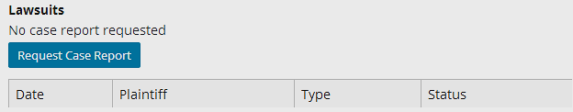
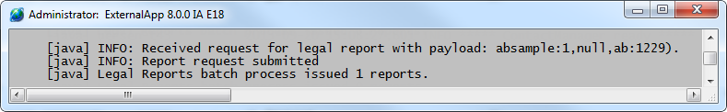
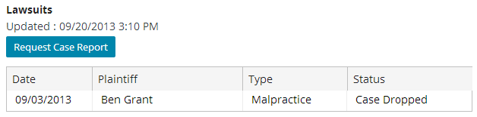
Example: Send to a web service
VendorRecommendation Transport Plugin
sending message
*** Stage 3(b) -- Sending the message ***
Transport plugin: LegalReportTransport -- send()
Sending payload to web service 1227
Notes:
The LegalReportTransport class's send() method uses a web service collection to send a request to ExternalApp using ExternalApp's submitReportRequest API. The ExternalApp console identifies it has received the message by printing INFO statements to the console.
In order to replicate this example in TrainingApp, ExternalApp must be running.

Slide 39
Best practices for sending messages
Pre-update rules and validation logic are NOT triggered from data changes made in send()
Each send() method should send the message to no more than one external system
Every message can have only one post-send status
Post-send status examples
Pending acknowledgement
Acknowledged
Retryable error
Other than message acknowledgement, after the message is sent, any processing should be minimal
Notes:
If a message is sent to multiple systems, then there is no way to clearly track the post-send status of the message.
Event Fired rules and messaging plugin implementations must be extremely careful about modifying entity data. They should perform only the minimal data changes necessary for integration with the target external system. Entity changes in these code locations will NOT run or rerun pre-update rules or validation logic, so these changes should not be made if preupdate or validation logic needs to be enforced. In general, this code should change only fields that are not modifiable from the user interface or API calls.
For similar reasons, it is unsupported (and dangerous) to add or delete entities from Event Fired rules or messaging plugins (even indirectly through other APIs).

Slide 40
Sending message plugins
SenderRefIDs and late binding
The message request plugin
The message transport plugin
Safe ordering
Retrying messages during sending

Slide 41
Sending simultaneous related messages
Account 117
(lost or delayed)
117 added
117 changed
117 changed
Who is account 117?
117 changed
117 changed
Some destinations create multiple messages for a single entity or a single set of related entities
Typically, they should not be sent at the same time
"Later" messages reference work done in "earlier" messages
If an earlier message gets lost or arrives late, a later message will not make sense
Notes:
Some of the slides in this section pertain exclusively to one product (PolicyCenter, BillingCenter, ClaimCenter, or ContactManager). The instructor may skip over slides that pertain to products that are not relevant to the course.

Slide 42
Safe ordering
Account 117
117 added
117 changed
117 changed
Guidewire has a built-in mechanism called safe ordering
Its primary purpose is to ensure that the external system gets related messages one at a time
When safe ordering is enforced:
For a given destination/entity pair, only one message is sent
The external system must acknowledge the first message before the next message is sent
Notes:
Safe ordering allows Guidewire to send messages as soon as possible, and yet prevents errors that might occur if related messages were processed out of order.
Safe ordering is not a simple first-in first-out order (FIFO). Messages are sent based on the order in which they must be received by the external system, which may or may not be identical to the order in which they were created in Event Fired rules.
This feature has large implications for messaging performance. Only one message can be in flight for each entity/destination pair. If the send queue contains 10 messages associated with different claims/accounts/contacts/producers, Guidewire can send all these safe-ordered messages immediately. However, if the send queue contains 10 safe-ordered messages for the same claim/account/contact/producer, Guidewire can send only one. Guidewire must wait for the message acknowledgement, and then at that point can send the next message, but once again can send only one.

Slide 43
Default ordering and sending behavior
Non-safe ordering messages sent…
Before safe-ordering message
In message creation order
Immediately
Safe-ordering messages sent…
After non-safe messages
In message creation order
Per entity instance, only one message at a time
region A added 10:01
first
nonSO
account B added 10:02
third
account B changed 10:03
???
region C added 10:04
second
nonSO
account D added 10:05
fourth
account D changed 10:06
???
Notes:
The example above represents a single destination with six messages. Two messages apply to regions. Two messages apply to account B. Two messages apply to account D. The time each message was created is also listed, and the messages appear in the order in which they were created.
First, Guidewire sends all the non-safe ordered messages. This is because non-safe ordered messages usually relate to "administrative" data that may be referenced by many other messages. Non-safe ordered messages are sent in the order they are created. (Therefore, the region A message is sent first, as it was created at 10:01. The region C message is sent second.) All non-safe ordered messages are sent immediately. Guidewire does not wait for any acknowledgement from the external system.
Next, Guidewire sends all the safe-ordered messages. As much as possible, safe-ordered messages are sent in the order that they are created. But, Guidewire sends only one message for a given entity/destination pair at a time. So, the send time of later messages for a given entity/destination pair depends upon when acknowledgement is received for earlier messages in that entity/destination pair. (Therefore, the "account B added" message is sent third. The "account B changed" message cannot be sent until the "account B added" message is acknowledged. Assuming there is no immediate acknowledgement of the message, the "account D added" message is sent fourth. The order and timing of the "account B changed" and "account D changed " messages is unknown because the sending of these messages depends upon the acknowledgement of the corresponding "account added" messages.)
(continued)

Slide 44
Notes:
Strict mode
Destinations have an option known as "strict mode". By default, it is turned off. Checking the destination's "Strict mode" turns it on.
When a destination is in strict mode:
Non-safe-ordered messages are sent one at a time. The next non-safe ordered message is not sent until the previous non-safe ordered message is acknowledged.
Safe-ordered messages are not sent until all non-safe-ordered messages have been sent and acknowledged.
This option is intended solely for destinations that send messages for multiple types of entities, and the order in which those messages are sent affects the external system's ability to understand them. Strict mode should be used cautiously, as it potentially affects the through-put of the destination because a single non-safe-ordered message that does not receive a positive acknowledgement will prevent the destination from sending further messages.

Slide 45
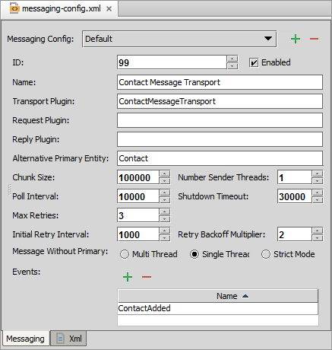
Safe ordering in ClaimCenter
By default, safe ordering applies only to messages related directly or indirectly to instances of Claim
Possible to configure a given destination to execute safe ordering at the Contact level
Allows for multiple messages to be in flight for the same Claim/destination pair, but only 1 message to be in flight for the same Contact/destination pair
Notes:
For most destinations, the default behavior of Claim-based safe ordering is appropriate.
However, some destinations represent integration points to a contact management system such as Guidewire ContactManager. For these integration points, each message may pertain to only one contact, and there are no issues around sending multiple messages for the same claim at the same time provided that each message pertains to a different contact. For these destinations, you can define that safe ordering should be enforced at the Contact level. (This means a given claim may have multiple messages in flight, but it will never have more than one message in flight for any given contact.)
To configure a destination to do safe ordering at the Contact level, select "Contact" in the Alternative Primary Entity field. Contact is the only alternative primary entity in ClaimCenter.

Slide 46
Safe ordering in PolicyCenter
By default, safe ordering applies only to messages related directly or indirectly to instances of Account
Possible to configure a given destination to execute safe ordering at the Contact level
Allows for multiple messages to be in flight for the same Account/destination pair, but only 1 message to be in flight for the same Contact/destination pair
Notes:
For most destinations, the default behavior of Account-based safe ordering is appropriate.
However, some destinations represent integration points to a contact management system such as Guidewire ContactManager. For these integration points, each message may pertain to only one contact, and there are no issues around sending multiple messages for the same account at the same time provided that each message pertains to a different contact. For these destinations, you can define that safe ordering should be enforced at the Contact level. (This means a given account may have multiple messages in flight, but it will never have more than one message in flight for any given contact.)
To configure a destination to do safe ordering at the Contact level, select "Contact" in the Alternative Primary Entity field. Contact is the only alternative primary entity in PolicyCenter.

Slide 47

Safe ordering in BillingCenter
By default, safe ordering is not used for any messages
For each destination, you can enable safe ordering for one of the given entity types:
Account
Contact
PolicyPeriod
Producer
Notes:
Unlike ClaimCenter (where most business information is owned uniquely by a claim) or PolicyCenter (where most business information is owned uniquely by an account), BillingCenter does not have a single entity whose instances uniquely own most of the business information. Therefore, BillingCenter does not have a single entity that is the default safe-ordered entity. The default is not to use safe ordering, and safe ordering must be enabled for each destination with the appropriate entity.
Because safe ordering reduces the likelihood of errors on the external system and can increase performance, the best practice is to enable safe ordering for every destination that can make use of it.
To configure a destination to do safe ordering, select the appropriate entity type (Account, Contact, PolicyPeriod, or Producer) in the Alternative Primary Entity field.

Slide 48
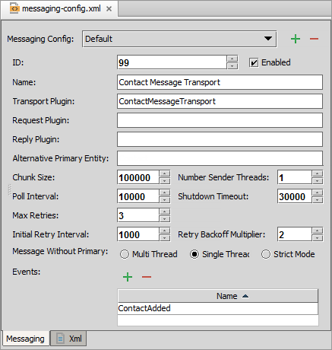
Safe ordering in ContactManager
In ContactManager (and TrainingApp), messages are safe ordered based on ABContact
This is true for every destination
There are no alternative primary entity types

Slide 49
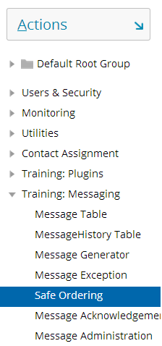
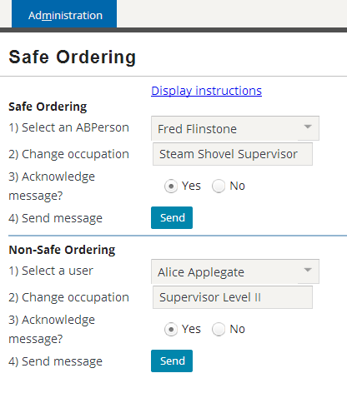
Safe ordering demo in TrainingApp
Administration → Training: Messaging → Safe Ordering
Notes:
TrainingApp includes a safe ordering demo. Using this demo, you can select and change either an ABContact or a User. You can send a message with acknowledgement or without acknowledgement. Message activity is printed to the console. Using this demo, you can see that:
If two messages are sent for the same ABContact (a safe-ordering entity), the second message is sent only if the first message is acknowledged.
If two messages are sent for the same User (a non-safe-ordering entity), the second message is always sent, regardless of the acknowledgement of the first message.
The demo is located on the Administration tab's "Training: Messaging→Safe Ordering" screen. Detailed instructions for how to use the demo are also included. To view the instructions, click the "Display demo instructions" link at the top of the detail view.

Slide 50
Sending message plugins
SenderRefIDs and late binding
The message request plugin
The message transport plugin
Safe ordering
Retrying messages during sending

Slide 51
Three retry scenarios
An error occurs during the initial send
An external system reports a Retryable Error and Guidewire sends another copy of the message
An admin retries a message manually
Initial send error
Retryable error
Guidewire application
External system
Manual retry
Notes:
A retryable error is an error in which the external system received the message but could not process it, and the reason for the error is expected to be temporary (such as when the error resulted from a network resource being unavailable).
To distinguish between the three scenarios used above, this course uses the terms "(automatic) retry during send", "(automatic) retry after send", and "manual retry".

Slide 52

Automatic retry during send (1)
Initial send error
When Transport or Request plugins throws an unchecked exceptions, the Guidewire application automatically
Compares message send attempts to Max Retries
Waits the Initial Retry Interval
Retries to send message
Increases the time between resends (Retry Backoff Multiplier)
Continues until reaching Max Retries
Parameters defined in message destination
Notes:
Sometimes, a message request or transport plugin has a send error and expects it to be temporary. For example, a database connection may not be available, or an initial attempt to reach the external system may have timed out. If the request plugin throws an exception from its beforeSend() method, or if the transport plugin throws an exception from its send() method, the application retries the message after a delay time. Guidewire halts sending other messages for that destination pair during the retry delay.
Destinations have specific parameters that impact how messages are retried.
Initial Retry Interval - The amount of time (in milliseconds) to wait before attempting to resend a message after an exception is thrown.
Max Retries - The number of retries to attempt
Retry Backoff Multiplier - The amount to increase the time between resends, specified as a multiplier of the time previously attempted.
Shutdown Timeout - The length of time to wait before attempting to shut down the messaging subsystem.
Messaging plugins have methods to suspend, resume, and shutdown the system. During the suspend(), shutdown(), and resume() methods of the plugin, the plugin must not call any APIs that suspend or resume messaging destinations. This includes—but is not limited to—MessageToolsAPI web service APIs. Doing so creates circular application logic.
(continued)

Slide 53
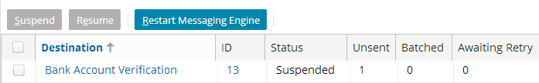
Automatic retry during send (2)
1
2
3
Event Messages
Guidewire automatically suspends the message destination when exceeding Max Retries
No further messages are sent for destination
An administrator must manually resume the destination
The message that caused the suspend will be resent, up to the maximum retries if necessary
Notes:
A message causes the destination to be suspended when:
The beforeSend() or send() method throws an exception, AND
The message has reached the retry limit.
If the message that throws the exception is safe-ordered, the next message for the entity/destination pair is not sent until the first message has been sent successfully and acknowledged in some fashion.

Slide 54
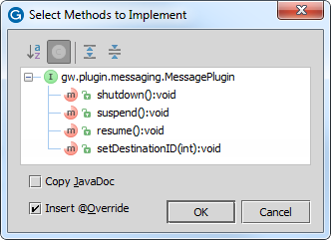
Configuring destination suspension
Implement methods for Transport, Request, and Reply plugins
suspend()
When messaging destination suspended
resume()
When messaging destination resumed
shutdown()
When application server shuts down
Notes:
The resume(), shutdown(), and suspend() methods are called by the application when the destination is resumed, or suspended, or the server shuts down. Plugins should acquire or release external resources at these times. For example, a plugin may need to create or close JMS or JDBC connections, JMS Sessions, sockets, and so on.
Typically, these methods are empty in a request plugin. In a production environment, they should be implemented for transport and reply plugins.
The plugin should throw a Guidewire InitializationException (com.guidewire.pl.plugin.messaging.InitializationException) from resume() if the resources have not initialized successfully. (A manual resume could be attempted later and may be successful.)
The setDestinationID method is not related to how a message is suspended or resumed. It allows your destination to get its own destination ID to store it in a private variable. Your code can use the stored destination ID value for logging messages or send it to integration systems so that they can programmatically suspend/resume the destination if necessary. Keep in mind that the valid range for your destination IDs is 0 through 63, inclusive. Guidewire reserves all other destination IDs for built-in destinations, such as the email transport destination.

Slide 55
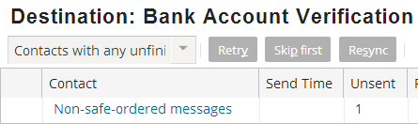
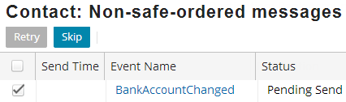
Retry and skip messages
Manual retry
Event Messages
Notes:
Every Guidewire application has an Event Messages screen on the Administration tab. The Event Messages screen shown above is present in every Guidewire application. It is used to administer messages.
To manually retry or skip a specific message:
From the "Event Messages" screen, click the Destination name.
From the "Destination: <Destination Name>" screen, click the appropriate link.
If the destination has messages associated to non-safe-ordered entities, the screen will have a "Non-safe-ordered messages" link.
If the destination has messages associated to safe-ordered entities, the screen will have a "Safe-ordered messages" link for each safe-ordered entity.
From the next screen, click the appropriate message or messages. Then, click "Retry" or "Skip".
When you manually retry a message, Guidewire attempts to resend the message by calling the same methods as the first attempt: the beforeSend() method (if a reply plugin has been implemented) and the send() method. If the issue that caused the original problem has not been rectified, the message will cause another exception, and after the Max Retries has been exceeded, the destination will be suspended again.
When you skip a message, the message is moved from the Message table to the MessageHistory table. The status of the message is set to "13" (skipped). Then the next message in its order (if there is one) can be sent. Note that skipping a message implies that the information that it was expected to carry to the external system is lost. When programming for messaging, care should be taken to avoid programming in such a way that large numbers of messages may be inadvertently skipped.

Slide 56
Contrasting retry scenarios
 | Automatic retry during send | Automatic retry after send | Manual retry
What is the problem? | Exception thrown in beforeSend() or send() | * | Message needs manual intervention
What executes the retry? | Internal Guidewire behavior | * | Admin (using Retry button)
Should each attempt use the same SenderRefID | Yes | * | Yes
What specifies the max retry number? | Max Retries property for messaging destination | * | n/a
What happens when the max number of retires is reached? | The destination is suspended | * | n/a
* Discussed in the Acknowledging Messages lesson
Notes:
A message could be retried automatically during the sending of the message.
This occurs when an exception is thrown in the beforeSend() or Send() method. The message is tried automatically as an internal Guidewire application behavior. Because the message has not yet been sent, each attempt should use the same SenderRefID. (Therefore, code should set the SenderRefID only if it is null.) The maximum number of retries is specified by the message's destination's Max Retries property. If a given message exceeds the maximum number of retries, then the destination is suspended. (No more messages are sent from this destination until the destination is resumed.)
A message could be retried manually.
This occurs when a message requires manual intervention. (This could be necessary for several reasons, such as a message that caused an exception during send() where the situation has now been rectified, or a message whose payload needed to be modified manually, or a message for which the external system never provided a response.) An admin retries the message manually by selecting the message from one of the Message Administration screens and clicking the Retry button. There is no notion of maximum retries for a message retried manually. A message could be retried automatically after the sending of the message. This is discussed in detail in the "Acknowledging Messages" lesson.

Slide 57
Describe the plugins used in sending messages
Set sender reference IDs and late bind messages
Write message request plugins
Write message transport plugins
Describe the functionality of safe ordering
Describe how errors are handled when sending messages

Slide 58
With regards to payload generation and payload transformation:
On which server does each take place?
At what point in time does each take place?
Under what circumstance would you need to "late bind" a message payload?
Every destination can optionally have a request plugin, but it must have a transport plugin. Why is the transport plugin required?
Can one destination have two transport plugins? Can one transport plugin be used by two destinations?
Why should the send() method never send a message to multiple external systems?
Notes:
Answers
1.a) Payload generation occurs on the application server. Payload transformation occurs on the batch server.
1.b) Payload generation occurs during Event Fired rules (right after the triggering event occurs). Payload transformation occurs right before the message is sent (in the request plugin's beforeSend() method, which is called immediately before the transport plugin's send() method).
2. You would need to "late bind" a message if information that needs to go in the message payload is not known at the time the message payload is generated in Event Fired rules.
3. The transport plugin is required because it is used to send the message when it is processed from the Message table. Without a transport plugin, messages for a given destination would have no way of being sent to the corresponding external system.
4. A destination cannot have two transport plugins, but a transport plugin class can be used by two (or more) similar destinations.
5. The message acknowledgement architecture assumes that each message is sent to only one destination. If a given send() method sent a message to multiple destinations, then there could be multiple acknowledgements, errors, or unprocessed messages, and the messaging architecture would not be able to identify the state of the message.

